Slide 1
Kusari
BCGDV dAppathon 2017

Slide 2
Problem - Collusion in RFP Process
Public organizations host a Request For Proposal (RFP), soliciting proposals from vendors.
These are often multi-billion $$$ projects
Documented cases of collusion, increasing project costs

Slide 3
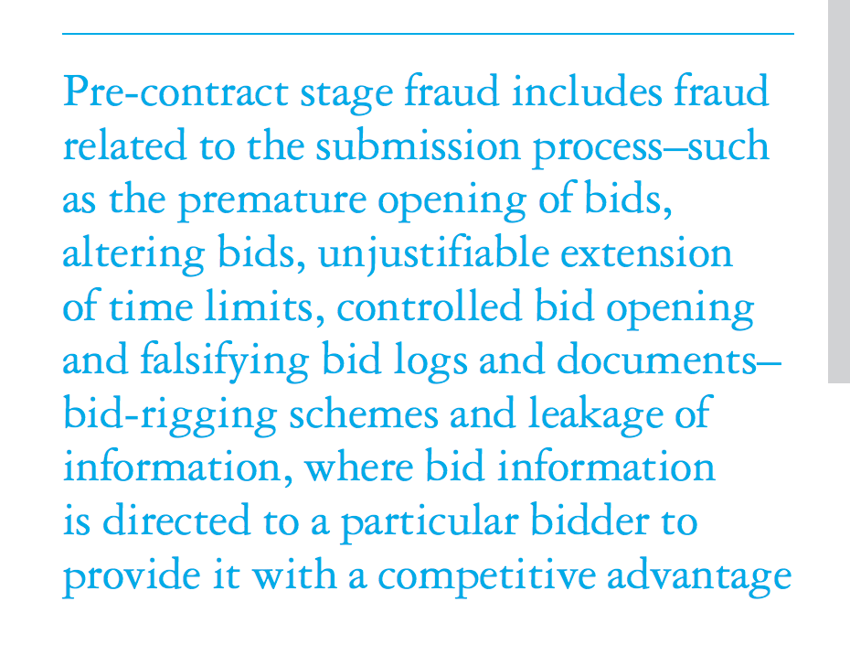
Deloitte Analysis
https://www2.deloitte.com/content/dam/Deloitte/xe/Documents/About-Deloitte/mepovdocuments/mepov13/dtme_mepov13_Procurement%20fraud.pdf

Slide 4
Solution
Kusari is a decentralized protocol that removes need for trust and ensures openness in the RFP process, preventing collusion for multi-billion dollar bids.

Slide 5
Preventing Collusion
Immutable Proposals
Auditable History
Robust
Enforced Schedule

Slide 6
Notes:
Proposals encrypted and stored in IPFS with one-time key pair
Contractor hold private key
Public key and IPFS hash stored on blockchain
At reveal, all bidders submit private key to blockchain
Fully auditable

Slide 7
Demo

Slide 8
Business & Future Scope
Integrate with current ERP systems
Provide customized integrated solutions for RFP process
Global solution for general procurement
Proposal submissions in KVP
Machine learning on submissions
Recommendations for selecting proposals
Risk analysis of bidders

Slide 9
Team
Adam Peretti, Snohomish County PUD
Rishabh Indoria, M.S. CS Program, USC
Kosuke Yano, DV Seattle
DJ Carter, DV Seattle

